Slide 1
WorkshopPlus: Azure AI Platform and Services
Provisioned Throughput Reservations

Slide 2
Objectives
After completing this Learning, you will be able to:
Understand….
Understand the challenges of Pay-As-You-Go (PayGo) AI deployments
Define and explain Provisioned Throughput Units (PTUs). Compare PayGo and PTU models.
Discover the different deployment and pricing options (hourly, reservation), and how to choose between global, data zone, and regional deployments.
Explore the value and benefits of PTUs, Understand quota management and monitoring. Apply best practices for PTU reservation

Slide 3
Obstacles to launching Gen AI use cases with PayGo deployment
Latency
PayGo is ideal for use cases resilient to throughput variability or slowness when service is busy
Variable throughput
Depending on how busy the service is, throughput can vary on PayGo deployment as shared processing capacity is utilized.
Limited scale
PayGo is designed with Tokens-per-minute bounds to ensure all users have a good experience. However, those thresholds may not suffice as you scale.
Managing cost
Using a PayGo API means costs accrue until the end of the month, making it difficult to forecast costs or price of GenAI features.
Notes:
Opening Thought: While Standard Deployments (Pay-as-you-Go) are an important option for of AI deployments – the model comes with some inherent challenges
Defining Latency and Throughput: Start by defining the terms for clarity. Latency is the time delay before a transfer of data begins following an instruction, which in Gen AI could affect real-time decision-making. Throughput is the amount of data processed successfully within a given time frame; essential for the efficiency of Gen AI applications.
Impact on Gen AI: Quickly explain that high latency can delay responses in AI interactions, while variable throughput can mean inconsistent AI performance.
Scaling and Costs: Highlight that PayGo's token limits can restrict scaling Gen AI services and fluctuating costs make financial planning for AI projects challenging.

Slide 4
What are Provisioned Throughput Units (PTUs)?
Assigned latency per token
Predictable TPM* throughput
Provisioned throughput units (PTU) are units of model processing capacity that customers can reserve and deploy for processing prompts and generating completions.
PTU
Choice in handling traffic
Reserved capacity
Notes:
Defining PTUs: Start by defining Provisioned Throughput Units (PTUs) as reserved blocks of processing capacity that customers can purchase. They allow for processing prompts and generating AI model completions without delay.
Advantages of PTUs: Highlight the key benefits of PTUs, including:
Assigned Latency: Each token has a designated response time, which means predictable performance for the end-users.
Predictable Throughput: With PTUs, you get a stable tokens per minute (TPM) rate, ensuring a consistent processing speed.
Traffic Management: PTUs give customers the flexibility to manage traffic, allowing them to handle workloads more effectively.
Reserved Capacity: Discuss the concept of reserved capacity, which ensures resources are dedicated to the customer’s workload, eliminating the need to compete for computing power.
Use-Case Scenarios: Conclude with potential use-case scenarios where PTUs would be especially beneficial, such as high-traffic applications, real-time processing requirements, or critical business operations that rely on AI.
Remind the audience that PTUs are an investment in reliability and performance consistency, especially crucial for enterprise-level AI implementations.
#################
You can use the provisioned throughput you requested across a diverse portfolio of models that are sold directly by Azure. These models include Azure OpenAI models and newly introduced flagship model families like Azure DeepSeek, Azure Grok, Azure Llama, and more within Microsoft Foundry Models.
Provisioned throughput provides:
A boarder model choice on the latest flagship models
Flexibility to switch models and deployments with given provisioned throughput quota
Significant discounts and the ability to boost your reservation utilization with a more flexible reservation choice
Predictable performance, by providing stable max latency and throughput for uniform workloads.
Allocated processing capacity: A deployment configures the amount of throughput. Once deployed, the throughput is available whether used or not.
Cost savings: High throughput workloads might provide cost savings vs token-based consumption.

Slide 5
Value of Provisioned Throughput Units(PTU)
State-of-the-art models
Top performance
Cost efficiency
Secure enterprise-ready AI
High Capacity
Flexibility
Notes:
emphasize the unique benefits PTUs bring to the table:
Infinite Scalability: Regardless of your operation's size or demand, PTUs adapt seamlessly, ensuring your AI services are always up and running without a hitch.
Reliable Performance: Guarantee throughput and maximum latencies with PTUs, ensuring smooth and efficient application performance at all times.
Predictable Costs: Move away from the unpredictability of Pay-As-You-Go models. PTUs allow for precise budgeting and financial planning, thanks to their upfront cost structure.
Our customers' experiences speak volumes. Switching to PTUs has led to significant performance boosts and reduced latency, marking a drastic improvement in business operations and success.
In conclusion, PTUs are not just a feature; they are a cornerstone of reliable, high-performance AI service delivery. They provide the support your projects need to scale effectively, ensuring your applications perform optimally around the clock. Thank you for exploring the potential of PTUs to elevate your AI initiatives."

Slide 6
Choosing the best Consumption Model
PayGo
Variable cost, Usage based
Capped Throughput
No assigned latency
Good for:
Sandbox/test environment
Lower volume workloads
Intermittent usage scenarios
Use cases resilient to throughput variability or slowness when service is busy
PTU
Consistent cost
Scalable throughput
Assigned latency
Recommended for:
Production workloads
High volume workloads
Throughput heavy workloads
Latency sensitive scenarios

Slide 7
Microsoft Foundry PTU Offerings
Provisioned pricing options
Provisioned
Offer
Global
Data
Zones
Regional
Deployment
Price
Hourly
Azure
Reservations
Hourly
Azure
Reservations
Hourly
Azure
Reservations
Notes:
Users have the option to choose three offerings when deploying Azure direct models*: standard, provisioned, or batch.
The Standard offering is optimized for low to medium volume workloads and offers flexibility with Pay-per-call pricing. This flexible, usage-based model with variable costs and capped throughput, is ideal for development, testing, and lower-volume workloads
The Provisioned offering is designed for high volume workloads and throughput-heavy applications
Users also have the option to choose where their data and workloads are processed: globally, data zones, or regionally.
Global deployments leverage Azure's global infrastructure to dynamically route customer traffic to the data center with the best availability for the customer’s inference request
Data zone deployments leverage Azure's global infrastructure to dynamically route customer traffic to the data center with the best availability for the customer's inference requests within the data zone defined by Microsoft.
Regional deployments leverage Azure's global infrastructure to dynamically route customer traffic to a specific region
When a customer decides to use provisioned and one of these deployments, they also have the choice on how to pay for these PTUs: hourly or commit with an Azure reservation

Slide 8
Saving with Microsoft Foundry
Hourly
Overview
Billed hourly per PTU
No long-term commitment
BEST FOR
Pilot projects
Development and testing workloads
Bursty or unpredictable usage
Azure Reservation
Overview
Discounted cost compared to hourly PTUs
Prepaid commitment for 1-month or 1-year term
BEST FOR
Production workloads
Enterprise apps with steady usage
Predictable monthly costs for stable workloads
PTU

Slide 9
Saving Cost with Azure Reservations*
Zone | Hourly PTU | One Month Reservation Per Month | One Year Reservation Per Month
Global | $1.00 | $260 | $221
Data Zone** | $1.10 | $260 | $221
Regional | $2.00 | $260 | $221
* Note: This pricing is only valid through 8.31.2025
** USA and EU data zones
Notes:
Benefits of Azure reservations:
Cost savings: Significantly save on PTUs as compared to hourly pricing.
Commit on your terms: Utilize one-month or one-year terms to support budget goals.
Agile and simple: Savings are applied automatically to provisioned units that match the deployment type and region in the reservation scope. Reservations are not model specific.
How it works:
Like other Azure reservations, the provisioned reservations are a billing mechanism in which users get a discounted price on their PTUs by committing to use a specific number of PTUs (ex: 50), deployment type (global, data zone, or regional), region (ex: US West) and timeframe (1-year)
Your Azure reservation will scan your environment based on your scope to identify the PTUs it can apply its savings to.
Your PTU deployment must match your Azure reservation commitment to get the discount. For example, if you deploy 50 Global PTUs in US West, your Azure reservation must also be Global and in US West.
With provisioned reservations you are able to significantly save on their PTU costs, support your budget goals by choosing a term that aligns to their financial plans, and see savings apply automatically to their PTU deployments

Slide 10
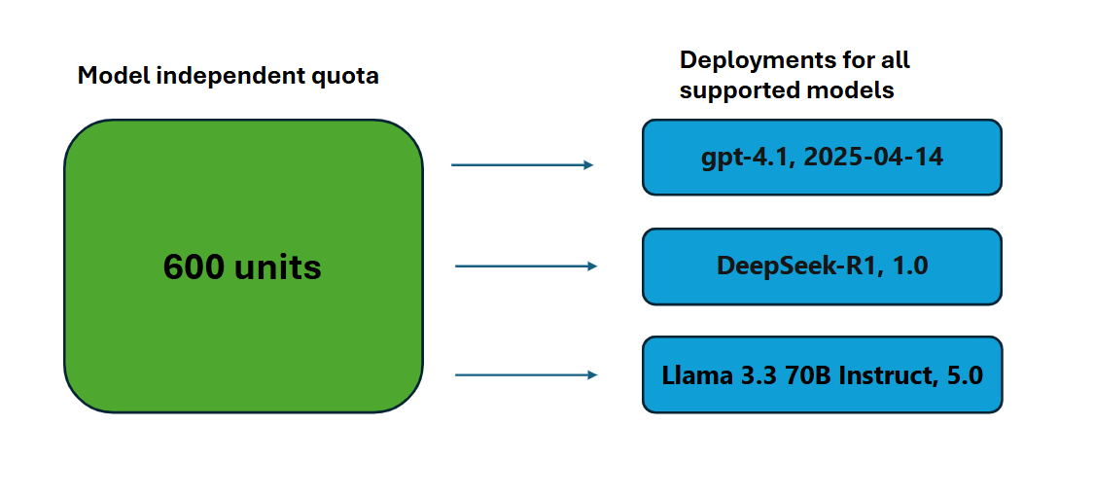
Model Independent Quota
Unlike the Tokens Per Minute (TPM) quota used by other Microsoft Foundry offerings, PTUs are model-independent.
The PTUs might be used to deploy any supported models hosted and sold directly by Microsoft in the region.
Notes:
https://learn.microsoft.com/en-us/azure/ai-foundry/openai/how-to/provisioned-throughput-onboarding#model-independent-quota
Quota for provisioned deployments shows up in Microsoft Foundry as the following deployment types: global provisioned, data zone provisioned and regional provisioned.
Models sold directly by Azure:
https://learn.microsoft.com/en-us/azure/ai-foundry/openai/concepts/provisioned-throughput?context=%2Fazure%2Fai-foundry%2Fcontext%2Fcontext&tabs=global-ptum#provisioned-throughput-capability-for-models-sold-directly-by-azure

Slide 11
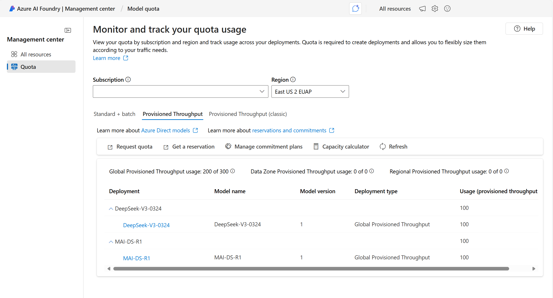
Monitor and track your Quota usage
Quota for provisioned deployments shows up in Microsoft Foundry as the following deployment types:
1) Global Provisioned,
2) Data Zone Provisioned and
3) Regional Provisioned.
Notes:
https://learn.microsoft.com/en-us/azure/ai-foundry/openai/how-to/provisioned-throughput-onboarding#model-independent-quota

Slide 12
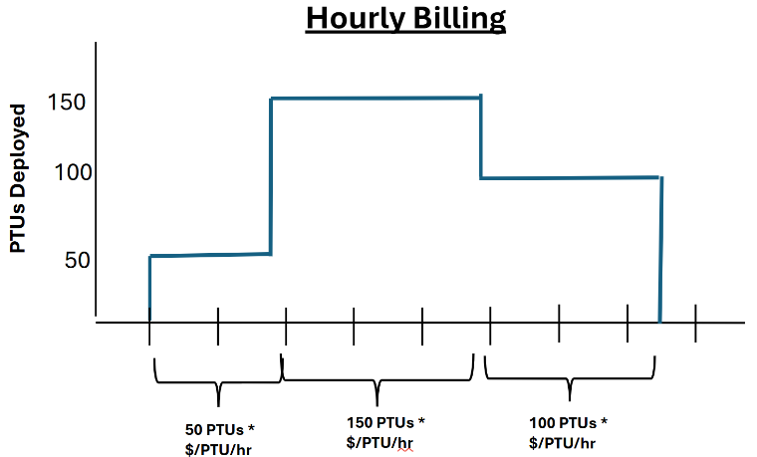
Hourly usage
Regional Provisioned, Data Zone Provisioned, and Global Provisioned deployments are charged an hourly rate ($/PTU/hr) on the number of PTUs that have been deployed.
Notes:
https://learn.microsoft.com/en-us/azure/ai-foundry/openai/how-to/provisioned-throughput-onboarding#model-independent-quota
* For example, a 300 PTU deployment will be charged the hourly rate times 300. All Microsoft Foundry model pricing is available in the Azure Pricing Calculator.
* If a deployment exists for a partial hour, it will receive a prorated charge based on the number of minutes it was deployed during the hour. For example, a deployment that exists for 15 minutes during an hour will receive 1/4th the hourly charge.
* If the deployment size is changed, the costs of the deployment will adjust to match the new number of PTUs.

Slide 13
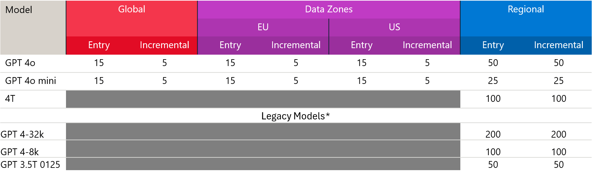
PTU Minimum/Increments per model and Deployment type
Notes:
https://learn.microsoft.com/en-us/azure/ai-foundry/openai/how-to/provisioned-throughput-onboarding?context=%2Fazure%2Fai-foundry%2Fcontext%2Fcontext#how-much-throughput-per-ptu-you-get-for-each-model
Note retirement dates for Legacy models: Azure OpenAI Service model retirements - Azure OpenAI | Microsoft Learn

Slide 14
Demo:
Estimate PTU using Capacity planner
Objectives
Select the deployments type
Choose the model and version
Estimate using input and output Tokens Per Minute(TPM)
Estimate using request data
Notes:
##########
https://learn.microsoft.com/en-us/azure/ai-foundry/openai/how-to/provisioned-throughput-onboarding?context=%2Fazure%2Fai-foundry%2Fcontext%2Fcontext
The capacity calculators provide an estimate based on simple input criteria. The most accurate way to determine your capacity is to benchmark a deployment with a representational workload for your use case.
Example scenario - In Microsoft Foundry, heading to the management center to check the quota. On the quota page, I'll select the capacity calculator and focus on the GPT-4o model for my agent. I'll clear existing workloads and add a new one for a foreign agent I'm building. I'm expecting about 20 peak calls per minute, with 2,000 average tokens in the prompt and 1,000 in the completion. Running the calculator, I find I need 50 PTUs for the required throughput. With this information, I'll go to the GPT-4o model in the catalog and deploy it. I'll choose global provision throughput and select 50 PTUs for deployment, ensuring the guaranteed throughput for our agent

Slide 15

Exchange Reservations - example
Example - Exchange 50 Regional provisioned reservations:
Deployment type
from Regional deployments to Data Zone or Global deployments
Region
from US West to Sweden Central
Term commitment
from 1-month to 1-year commitment
Payment Option
from All Upfront to monthly payment
Notes:
IMPORTANT: Financial criteria must be met to exchange reservations.

Slide 16
Best practices
Purchase reservations after deployments have
Provisioned Reservations
Review the auto-renewal setup and dates
Remember reservations for Global, Data Zone, and Regional deployments aren't interchangeable. You need to purchase a separate reservation for each deployment type
Monitor your reservation utilization via the Azure Portal to ensure it is receiving the usage you are expecting. Set up and use utilization alerts on conditions like unused commitments or billing overages in Microsoft Cost Management

Slide 17

Start saving today
Learn more
Reservation blog | Reservation blog
View your recommendation | Azure Advisor
Purchase a plan | Azure portal
Documentation | Provisioned Throughput reservations Azure reservations
Training and Skilling | Learning Module
Watch demos | Azure Essentials Show
Additional resources | Microsoft Foundry Models
Provisioned

